Slide 1
5COSC020W DATABASE SYSTEMS – LECTURE 08
XML and XML Schema – Extensible Markup Language

Slide 2
LECTURE 08 – OUTLINE
Semi-structured data
XML eXtensible Markup Language
XML tree structure.
XML elements and attributes.
Well-formed and valid XML documents
XML Document Type Definition (DTD)
XML Schema Definition (XSD)
Declaring attributes.
Declaring simple and complex elements.
Declaring order and occurrence indicators.
Declaring constraints

Slide 3
Classifying DBMSs based on Data Models (recap)
Relational Model or SQL Model (covered in lectures 01-07)
Structured Data as collection of tables with fields, records, PKs and FKs.
Uses high level Structured Query Language (SQL) for CRUD operations.
XML Model (covered in lectures 08-10)
Semistructured data as elements that can be nested to create tree structures.
Standard for structuring and exchanging data over the Web.
NoSQL Model (covered in lectures 11)
Key-value data model: each data value associated to unique key for fast retrieval.
Graph data model: data represented as graphs i.e. labelled nodes and edges.
Document data model: data as collection of documents in JSON or XML.
Object Model (not covered in this module)
Data as collection of objects (in classes) with properties & operations.

Slide 4
Structured, semi-structured & structured data
Structured Data
Data stored in very organised manner, represented according to strict schema.
Example – data stored in a relational DB based on the relational model: interrelated tables with attributes in a domain and tuples of single record.
Semi-structured Data
Data irregular or incomplete, may change rapidly or unpredictably.
Data does not conform to fixed schema: not all data have same structure, attributes may exist only in a few data objects but not in all.
No separation of data and schema: schema constructs mixed with data values.
Example – bibliography: books, tech reports, journal articles, conf proceedings.
Unstructured Data
No indication of any type of data organisation or schema.
Example – text stored online in HTML with formatting tags

Slide 5
Example of Semi-structured Data – a bibliography
Book
Title: Database Systems – Practical Approach to Design, Implementation & Mgmt
Authors: Thomas M. Connolly and Carolyn E. Begg
Edition: 6th
Publisher: Pearson
Year: 2015
Articles
Journal Article
Title: ‘Nanostandardization’ in Action
Authors: F. Roubert and A.Hool
Journal name: NanoEthics – Studies of New and Emerging Technologies
Publisher: Springer
Year: 2016
Conference paper
Title: Supporting Coordination in Large, Multi-site Research
Authors: F. Roubert and M. Perry
Conference name: 27th International BCS Human Computer Interaction Conference
Organiser: British Computer Society
Year: 2013

Slide 6
XML – eXtensible Markup Language
XML
Standard for storing, structuring and distributing data over the Web.
Markup language designed to carry data (unlike HTML, designed to display data).
Self-descriptive tech that provides info on both structure and value of data.
Key Characteristics
Standard for Web exchanges: allows for automatic interpretation of content.
Simple: text-based, easy to read, can handles upgrades (OSs, software, browser, etc).
Open standard: software- and hardware- independent.
Extensible: elements and attributes defined by users for own needs.
Separation of content and presentation: “write once, publish anywhere”.
Integration of data from multiple sources e.g. DBs and various applications.

Slide 7
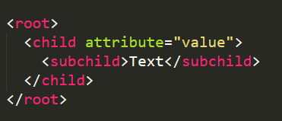
XML Data Model – The Tree Structure
XML Document formed as elements trees
XML tree starts at a root element and branches from the root to subelements.
‘parent’, ‘child’ and ‘sibling’ used to describe relationships between elements.
Elements, tags and attributes
Element: data value with start tag and end tags and sometimes attributes.
Tags: describe the meaning of the data element e.g. <NAME> or <SALARY>.
Attributes: additional info to describe elements e.g. <STAFF branchNo="B005">.
⚠️ Attribute does not have the same meaning as in relational databases.

Slide 8
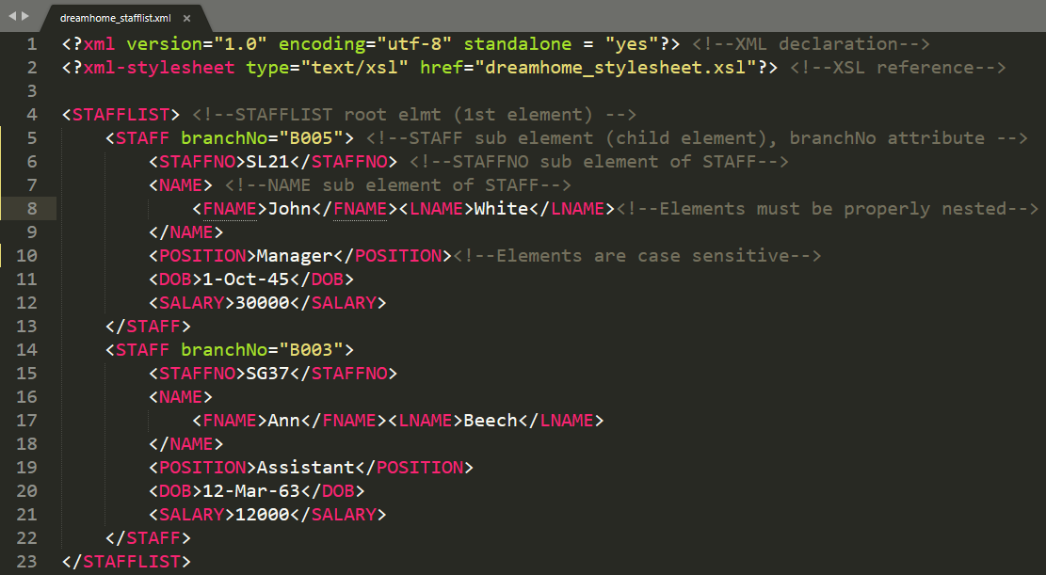
EXAMPLE 1: XML Document – dreamhome_stafflist.xml

Slide 9
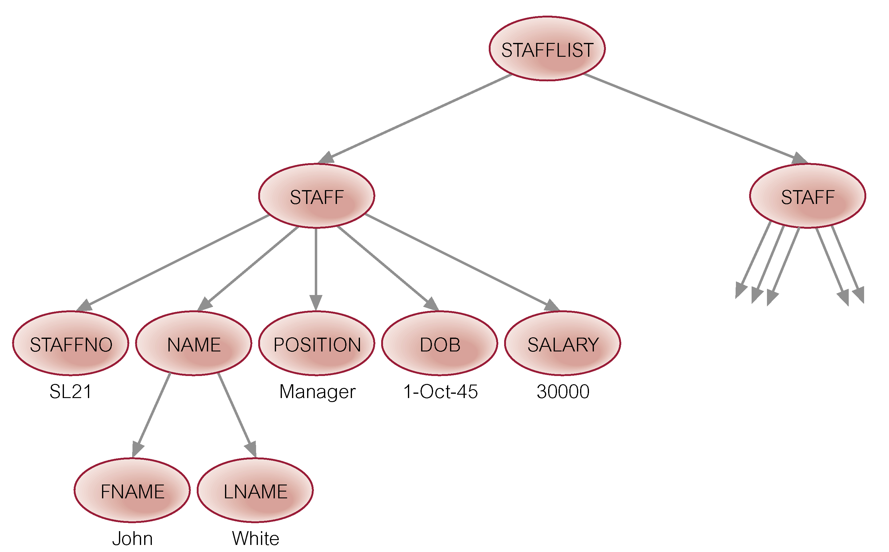
Example 1: Tree Structure – dreamhome_stafflist.xml

Slide 10
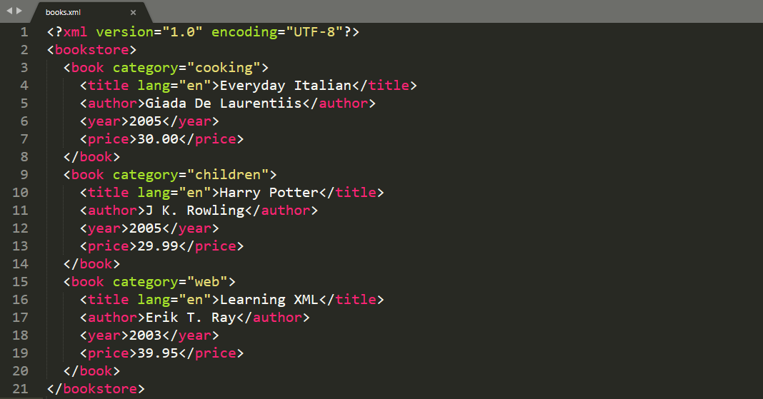
EXAMPLE 2: XML Document – books.xml

Slide 11
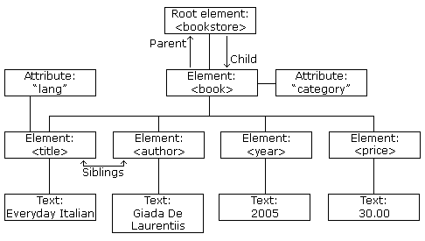
Example 2: Tree Structure – books.xml

Slide 12
XML Elements vs. Attributes?
In Theory:
No rules when to use attributes or when to use elements in XML.
<STAFF>
<STAFFNO>SL21</STAFFNO>
<NAME> John White </NAME>
<POSITION>Manager</POSITION>
</STAFF>
<STAFF position = "Manager">
<STAFFNO>SL21</STAFFNO>
<NAME> John White </NAME>
</STAFF>
=
In Practice:
Use elements as they can contain multiple values and can be nested.
Use attributes for ID references to identify XML elements (like a PK) or to reference another element in another part of the XML document (like a FK).
<STAFF staffNo="SL21">
<NAME> John White </NAME>
<POSITION>Manager</POSITION>
</STAFF>
<STAFF branchNo="B005">
<STAFFNO>SL21</STAFFNO>
<NAME> John White </NAME>
<POSITION>Manager</POSITION>
</STAFF>

Slide 13
Well-formed XML Documents
Well-formed XML document:
Syntactically correct document.
Can be processed automatically.
Can be represented by a tree structure.
It starts with a declaration that specifies version, encoding & standalone.
It has a single root element and proper nesting.
Every element has matching pair of start and end tag within parent element.
No-predefined set of elements limits automatic interpretation of meaning.

Slide 14
Valid XML Documents
Valid XML document: document that follows a structure defined externally i.e. in a separate file.
Document Type Definition (DTD)
XML Schema Definition (XSD)

Slide 15
XML Document Type Definition (DTD)
Document Type Definition (DTD)
Defines the structure and the legal elements and attributes of XML document in separate DTD file.
Declares elements with “parsed character data” & attributes with “character data”.
Limitations
Data types not very general.
Has its own syntax, does not follow the syntax rules of XML.
Requires separate processor in addition to XML processor.
Has to follow ordering of the XML document, unordered elements not permitted.

Slide 16
XML Schema Definition (XSD)
XML Schema Definition
Standard for specifying structure of XML document in separate XSD file.
Formalisation of constraints expressed as rules or a model of structure.
Design tool i.e. framework on which implementation can be built.
Standardised by World Wide Web Consortium (W3C) to consistently define the structure, content and semantics of XML documents.
Characteristics
Same syntax rules as XML, same processor can be used for both.
Based on tree structure with elements and attributes as main concepts.
Borrows concepts from relational and object models e.g. keys, references, identifiers.
Supports data types to describe and define restrictions on data.

Slide 17
XML Schema Definition – Purpose (1)
Validation
After being written, before being sent, when received, before being imported, etc.
Ensures that XML document conforms to expected set of rules.
Structural validation: ensures that element and attribute structures meet requirements.
Data validation: ensures that element and attributes conform to rules about expected info.
Business rules: checks relationships between info and higher level.
Documentation
Formal description of vocabulary of XML document in a concise manner.
Machine readable documentation.

Slide 18
XML Schema Definition – Purpose (2)
Transformation and querying support: languages rely on XSD
XPath: Language to address and navigate through an XML document by following the tree structure.
XSLT: Language to render and transform an XML document into a viewable output file.
XQuery: Query-based language to extract and retrieve data stored in XML format.
Data binding
Binds data values with structure of the data.

Slide 19
XML Schema – Initial Declaration, Namespace and Root
XSD file
<?xml version="1.0" encoding="UTF-8"?> to indicate that XSD uses XML syntax.
<xs: schema> to indicate that all elements, attributes and data types in schema prefixed with conventional prefix xs associated to namespace as defined in URL.
Start with the root declaration.
<?xml version="1.0" encoding="UTF-8" standalone="No">
<STAFFLIST>
…
</STAFFLIST>
XML
XSD
<?xml version="1.0" encoding="UTF-8"?>
<xs:schema xmlns:xs="http://www.w3.org/2001/XMLSchema">
<xs:element name="STAFFLIST">
…
</xs:element>
</xs:schema>
<STAFFLIST> is the root element

Slide 20
XML Schema – Declaring Simple Elements in XSD
Simple element
Does not contain child elements or attributes.
Declared and opened and closed within one tag.
Only contains data value of a certain data type.
Built-in data types: e.g. string, integer, decimal, float, boolean, date, time.
Custom data type: defined by the developer.
XML
XSD
<staffNo>21</StaffNo>
<fullName> John White </fullName>
<salary>85000.00</salary>
<DOB>1-OCT-63</DOB>
<xs:element name="staffNo" type="xs:string"/>
<xs:element name="fullName" type="xs:string"/>
<xs:element name="salary" type="xs:decimal"/>
<xs:element name="DOB" type="xs:date"/>

Slide 21
XML Schema – Declaring Attributes in XSD
Attribute
Declared as a simple type.
Declared and opened and closed within one tag.
Uses built-in data types e.g. string, integer, decimal, float, boolean, date, time.
⚠️ If an element has attributes, element has to be declared as complex element.
XML
XSD
<Staff staffId = "1234"/>
This is an empty element!
<xs:element name="Staff">
<xs:complexType>
<xs:attribute name="staffId" type="xs:integer"/>
</xs:complexType>
</xs:element>

Slide 22
XML Schema – Declaring Complex Elements in XSD (1)
Complex element
Contains child elements and/or attributes, including empty elements (only attributes).
Uses <xs:complexType> and Order Indicators and/or Occurrence Indicators.
<Branch>
<bNo>3412</bNo>
<bName>Kilburn Branch</bName>
<bOpDate>2 May 2020</bOpDate>
</Branch>
XML
XSD
<xs:element name="Branch">
<xs:complexType>
<xs:sequence>
<xs:element name="bNo" type="xs:integer"/>
<xs:element name="bName" type="xs:string"/>
<xs:element name="bOpDate" type="xs:date"/>
</xs:sequence>
</xs:complexType>
</xs:element>
<xs:sequence> order indicator: specifies that child elements appear in ordered list!

Slide 23
XML Schema – Declaring Complex Elements in XSD (2)
Complex element
Contains child elements and/or attributes, including empty elements (only attributes).
Uses <xs:complexType> and Order Indicators and/or Occurrence Indicators.
XML
XSD
<Branch bNo = "3412">
<bName>Kilburn Branch</bName>
<bOpDate>2 May 2020</bOpDate>
</Branch>
<xs:element name="Branch">
<xs:complexType>
<xs:attribute name="bNo" type="xs:integer"/>
<xs:sequence>
<xs:element name="bName" type="xs:string"/>
<xs:element name="bOpDate" type="xs:date"/>
</xs:sequence>
</xs:complexType>
</xs:element>
<xs:sequence> order indicator: specifies that child elements appear in ordered list!

Slide 24
XML Schema – Order Indicators in XSD
Order Indicators: 3 types
<xs:sequence>
Specifies that child elements appear in ordered list.
<xs:all>
Specifies that child elements appear in any order, each child element occurs once.
<xs:choice>
Specifies that either one child element or the other should appear, but not both.

Slide 25
XML Schema – <xs:sequence> Order Indicator
Order Indicator <xs:sequence>
Specifies that child elements appear in ordered list.
<House>
<houseNo>221B</houseNo>
<streetAddress>Baker Street, London</streetAddress >
<postCode>NW1 6XE</postCode>
</House>
XML
XSD
<xs:element name="House">
<xs:complexType>
<xs:sequence>
<xs:element name="houseNo" type="xs:string"/>
<xs:element name="streetAddress" type="xs:string"/>
<xs:element name="postCode" type="xs:string"/>
</xs:sequence>
</xs:complexType>
</xs:element>

Slide 26
XML Schema – <xs:all> Order Indicator
Order Indicator <xs:all>
Specifies that child elements appear in any order, each child element occurs once.
XML
XSD
<Student>
<fName>Jim</fName>
<lName>O’Rourke</lName>
</Student>
<xs:element name="Student">
<xs:complexType>
<xs:all>
<xs:element name="fName" type="xs:string"/>
<xs:element name="lName" type="xs:string"/>
</xs:all>
</xs:complexType>
</xs:element>

Slide 27
XML Schema – <xs:choice> Order Indicator
Order Indicator <xs:choice>
Specifies that either one child element or the other should appear, but not both.
<appUser>
<username>Bob78</username>
</appUser>
<appUser>
<email>kim43@email.com</email>
</appUser>
XML
XSD
<xs:element name="appUser">
<xs:complexType>
<xs:choice>
<xs:element name="username" type="xs:string"/>
<xs:element name="email" type="xs:string"/>
</xs:choice>
</xs:complexType>
</xs:element>

Slide 28
XML Schema Combining Order Indicators
<landmark>
<ldmrkname>Colosseum</ ldmrkname >
<location>Rome, Italy</location>
</landmark>
<landmark>
<ldmrkname>Tour Eiffel</ldmrkname>
<city>Paris</city>
<country>France</country>
</landmark>
XML
XSD
<xs:element name="landmark">
<xs:complexType>
<xs:sequence>
<xs:element name="ldmrkname" type="xs: string">
<xs:choice>
<xs:element name="location" type="xs: string">
<xs:sequence>
<xs:element name="city" type="xs: string">
<xs:element name="country" type="xs: string">
</xs:sequence>
</xs:choice>
</xs:sequence>
</xs:complexType>
</xs:element>

Slide 29
XML Schema – Occurrence Indicators in XSD
Occurrence Indicators: participation and cardinality
minOccurs = "0"
Indicates 0 occurrences of an element i.e. optional element.
minOccurs = "2"
Indicates a minimum of 2 occurrences of an element i.e. the element has at least 2 occurrences.
maxOccurs = "3"
Indicates a maximum of 3 occurrences of an element i.e. the element has at most 3 occurrences.
maxOccurs = "unbounded"
Indicates that there is no defined maximum number of occurrences.
minOccurs or maxOccurs not specified
Default value is 1.

Slide 30
XML Schema – Occurrence Indicators (1)
<Product>
<pName>Screen Box </pName>
<descrip>Damaged</descrip>
</Product>
<Product>
<pName>Computer Box</pName>
</Product>
XML
XSD
<xs:element name="Product" maxOccurs= "unbounded">
<xs:complexType>
<xs:sequence>
<xs:element name= "pName" type="xs:string"/>
<xs:element name= "descrip" type="xs:string" minOccurs= "0"/>
</xs:sequence>
</xs:complexType>
</xs:element>

Slide 31
XML Schema – Occurrence Indicators (2)
<Icecream>
<flavour>Vanilla</flavour>
</Icecream>
<Icecream>
<flavour>Lemon</flavour>
<flavour>Mango</flavour>
</Icecream>
XML
XSD
<xs:element name= "Icecream" maxOccurs= "unbounded">
<xs:complexType>
<xs:sequence>
<xs:element name="flavour" type="xs:string" minOccurs="1" maxOccurs="3"/>
</xs:sequence>
</xs:complexType>
</xs:element>

Slide 32
XML Schema – Occurrence Indicators (3a)
<paternal_family>
<person>
<full_name>Nick Morgan</full_name>
<child_name>Mike</child_name>
<child_name>Alex</child_name>
<child_name>Masha</child_name>
<child_name>Dan</child_name>
</person>
<person>
<full_name>Mike Morgan</full_name>
<child_name>Jennifer</child_name>
</person>
<person>
<full_name>Alex Morgan</full_name>
</person>
</paternal_family>
XML

Slide 33
XML Schema – Occurrence Indicators (3b)
XSD
<xs:element name="paternal_family">
<xs:complexType>
<xs:sequence>
<xs:element name="person" maxOccurs="unbounded">
<xs:complexType>
<xs:sequence>
<xs:element name="full_name" type="xs:string"/>
<xs:element name="child_name" type="xs:string" minOccurs="0" maxOccurs="5"/>
</xs:sequence>
</xs:complexType>
</xs:element>
</xs:sequence>
</xs:complexType>
</xs:element>

Slide 34
XML Schema – Constraints in XSD
<xs:unique> constraint
specifies that elements or attributes are to be unique.
<xs:key> constraint
like unique but value has to be non null (similar to a Primary Key).
<xs:keyref> constraint
value of attribute or element references a key (similar to a Foreign Key).
<xs:selector>
indicates the context/scope in XPath within which constraint is valid.
<xs:field>
indicates the element in XPath within which unique constraint applies.

Slide 35
XML Schema – Unique Constraint
<appUser>
<fullName>Kim Gordon </fullName>
<email>kim43@email.com</email>
</appUser>
XML
XSD
<xs:unique name="emailunique">
<xs:selector xpath="appUser"/>
<xs:field xpath="email"/>
</xs:unique>
<xs:element name="appUser">
<xs:complexType>
<xs:sequence>
<xs:element name="fullName" type="xs:string"/>
<xs:element name="email" type="xs:string"/>
</xs:sequence>
</xs:complexType>
</xs:element>
The unique constraint applies within the appUser element and on the email element.
Each app user is unique as identified by their email.

Slide 36
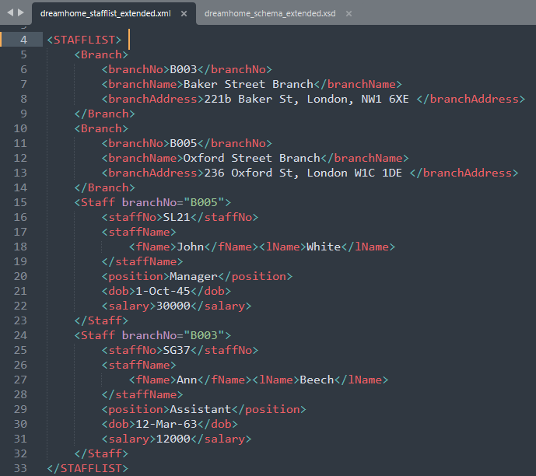
EXAMPLE 1 (expanded) – dreamhome_stafflist_extended.xml

Slide 37
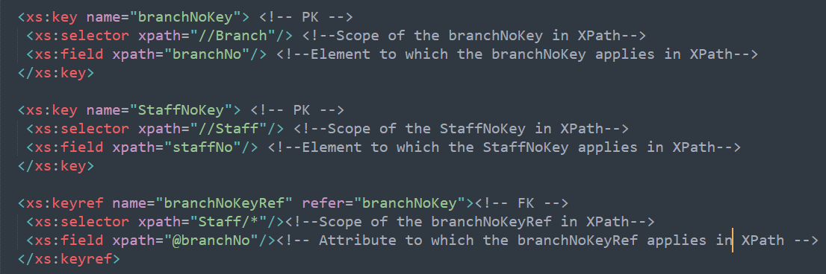
EXAMPLE 1 (expanded) – XSD for key & reference constraints
XSD file that contains the XML Schema for dreamhome_stafflist_extended.xml

Slide 38
REFERENCES
Connolly, T. & Begg, C. E. (2015). Database systems: a practical approach to design, implementation and management. 6th Edition (Global Edition). Pearson Education.
Elmasri, R. & Navathe, S. (2017). Fundamentals of Database Systems. 7th Edition (Global Edition). Pearson Education.
Goldberg, K. (2008). XML: Visual QuickStart Guide. 2nd Edition. Peachpit Press.
Liquid Technologies (2021). Free Online XML to XSD Converter. Available from https://www.liquid-technologies.com/online-xml-to-xsd-converter [Accessed 10 May 2021]
van der Vlist, E. (2002). XML Schema. O’Reilly.
W3Schools (2021). XML Tutorial. Available from https://www.w3schools.com/xml/default.asp [Accessed 10 May 2021]

